Slide 1
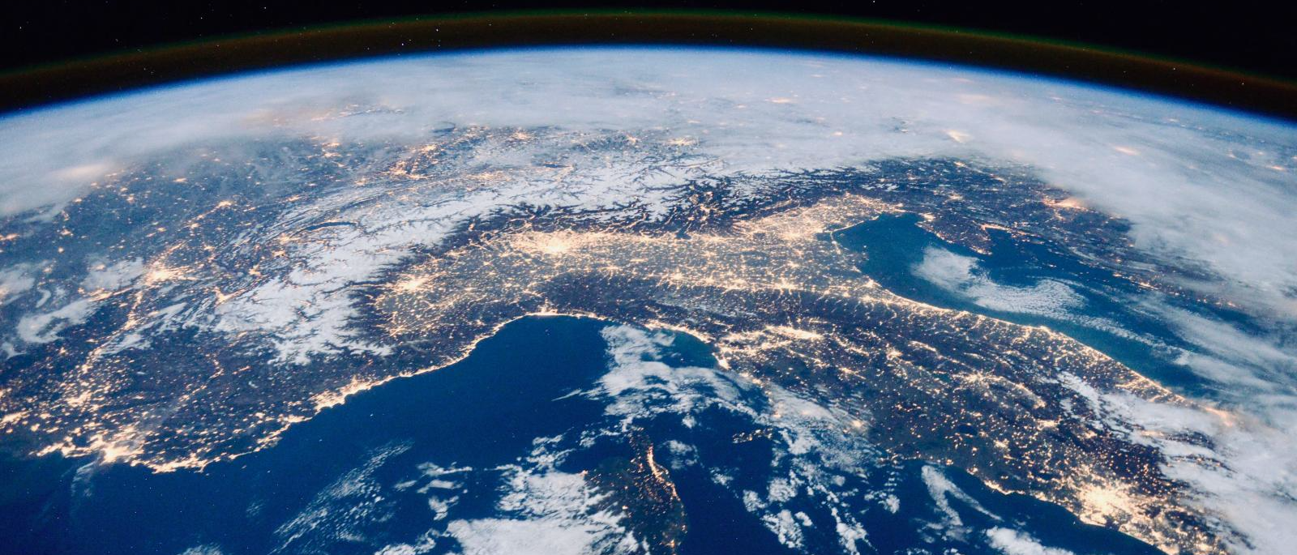
I will Shake all Nations . . . and the Desire of all Nations
Shall Come

Slide 2
For thus saith the LORD of hosts; Yet once, it is a little while, and I will shake the heavens, and the earth, and the sea, and the dry land;
And I will shake all nations, and the desire of all nations shall come: and I will fill this house with glory, saith the LORD of hosts.
Haggai 2:6,7

Slide 3
OVERVIEW
1. Context of Haggai 2:6,7
2. Elements of the Prophecy and Symbolic Meanings
3. Fulfillments – Current and Recent Events
4. Character Lessons for Us

Slide 4
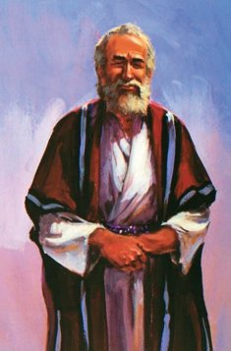

Slide 5
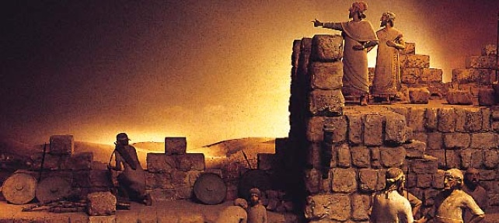

Slide 6
In the second year of Darius the king, in the sixth month, in the first day of the month, came the word of the LORD by Haggai the prophet, unto Zerubbabel the son of Shealtiel, governor of Judah, and to Joshua the son of Josedech, the high priest, saying,
Thus speaketh the LORD of hosts, saying, This people say, The time is not come, the time that the LORD'S house should be built.

Slide 7
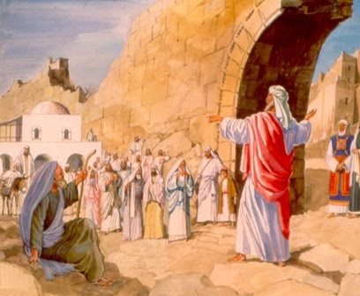
Then came the word of the LORD by Haggai the prophet, saying,
Is it time for you, O ye, to dwell in your cieled houses, and this house [the Temple] lie waste?
Now therefore thus saith the LORD of hosts; Consider your ways.

Slide 8
Ye have sown much, and bring in little; ye eat, but ye have not enough; ye drink, but ye are not filled with drink; ye clothe you, but there is none warm; and he that earneth wages earneth wages to put it into a bag with holes.
Thus saith the LORD of hosts; Consider your ways.
Go up to the mountain, and bring wood, and build the house; and I will take pleasure in it, and I will be glorified, saith the LORD.

Slide 9
Ye looked for much, and, lo, it came to little; and when ye brought it home, I did blow upon it. Why? saith the LORD of hosts. Because of mine house that is waste, and ye run every man unto his own house.
Therefore the heaven over you is stayed from dew, and the earth is stayed from her fruit.
And I called for a drought upon the land, and upon the mountains, and upon the corn, and upon the new wine, and upon the oil, and upon that which the ground bringeth forth, and upon men, and upon cattle, and upon all the labour of the hands.
Haggai 1:1-11

Slide 10
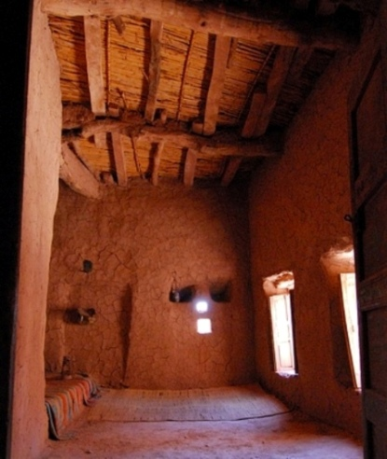

Slide 11
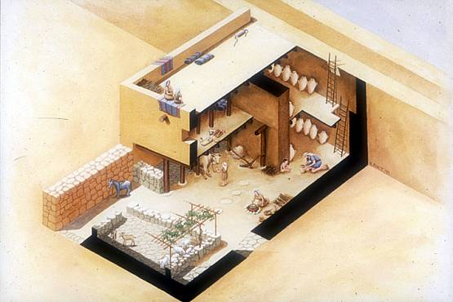

Slide 12
Yet now be strong, O Zerubbabel, saith the LORD; and be strong, O Joshua, son of Josedech, the high priest; and be strong, all ye people of the land, saith the LORD, and work: for I am with you, saith the LORD of hosts:
According to the word that I covenanted with you when ye came out of Egypt, so my spirit remaineth among you: fear ye not.
Haggai 2:4,5

Slide 13
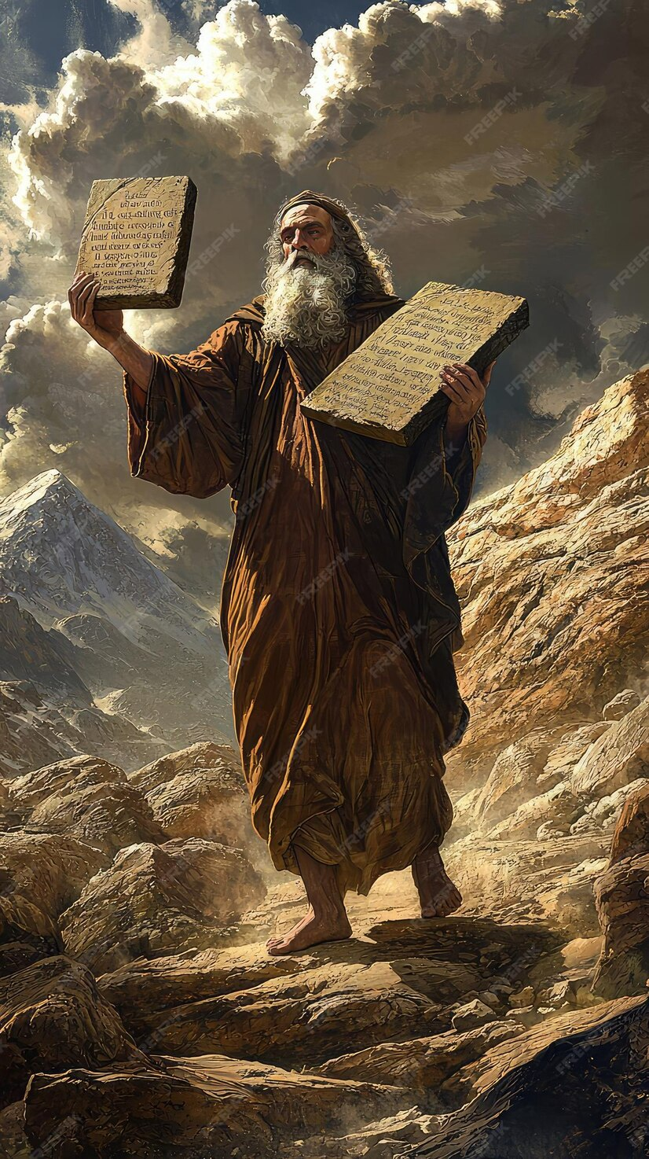

Slide 14
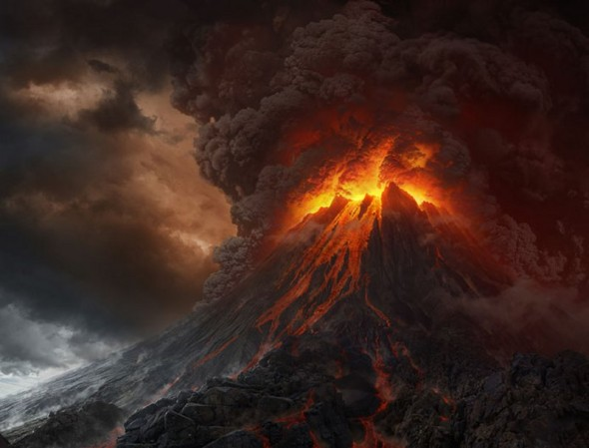

Slide 15
And mount Sinai was altogether on a smoke, because the LORD descended upon it in fire: and the smoke thereof ascended as the smoke of a furnace, and the whole mount quaked greatly.
Exodus 19:18

Slide 16
Elements of Haggai’s Prophecy
Yet once
A Little While
I Will Shake . . .
Heavens
Earth
Sea
Dry Land
All Nations
Desire of All Nations Shall Come
I Will fill this House with Glory

Slide 17
Elements of Haggai’s Prophecy
Yet once
A Little While
I Will Shake . . .
Heavens
Earth
Sea
Dry Land
All Nations
Desire of All Nations Shall Come
I Will fill this House with Glory

Slide 18
Whose voice then shook the earth: but now he hath promised, saying, Yet once more I shake not the earth only, but also heaven.
Hebrews 12:26

Slide 19
Whose voice then shook the earth: but now he hath promised, saying, Yet once more I shake not the earth only, but also heaven.
Hebrews 12:26

Slide 20
Elements of Haggai’s Prophecy
Yet once
A Little While
I Will Shake . . .
Heavens
Earth
Sea
Dry Land
All Nations
Desire of All Nations Shall Come
I Will fill this House with Glory

Slide 21
Elements of Haggai’s Prophecy
Yet once
A Little While: A short time, quickly
I Will Shake . . .
Heavens
Earth
Sea
Dry Land
All Nations
Desire of All Nations Shall Come
I Will fill this House with Glory

Slide 22
Elements of Haggai’s Prophecy
Yet once
A Little While
I Will Shake . . .
Heavens
Earth
Sea
Dry Land
All Nations
Desire of All Nations Shall Come
I Will fill this House with Glory

Slide 23
Elements of Haggai’s Prophecy
Yet once
A Little While
I Will Shake (Strong’s 7493 – Undulate: trouble, turmoil)
Heavens
Earth
Sea
Dry Land
All Nations
Desire of All Nations Shall Come
I Will fill this House with Glory

Slide 24
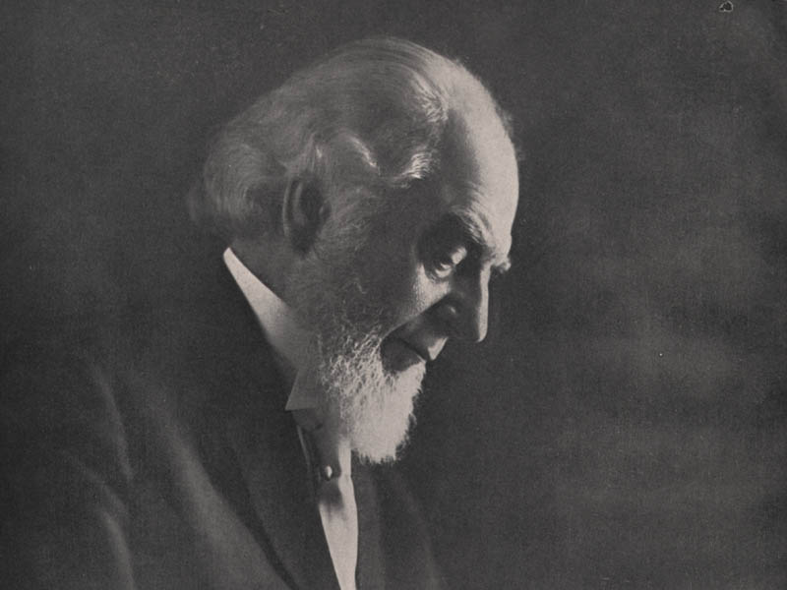
Throughout the Scriptures, earth, when used symbolically, represents society; mountains represent kingdoms; heavens, the powers of spiritual control; seas, the restless, turbulent, dissatisfied masses of the world. Fire represents the destruction of whatever is burned--tares, dross, earth (social organization), or whatever it may be.
Volume 1 Page 318

Slide 25
Elements of Haggai’s Prophecy
Yet once
A Little While
I Will Shake . . .
Heavens
Earth
Sea
Dry Land
All Nations
Desire of All Nations Shall Come
I Will fill this House with Glory

Slide 26
Elements of Haggai’s Prophecy
Yet once
A Little While
I Will Shake . . .
Heavens: Powers of Spiritual Control, Nominal Churches
Earth
Sea
Dry Land
All Nations
Desire of All Nations Shall Come
I Will fill this House with Glory

Slide 27
Elements of Haggai’s Prophecy
Yet once
A Little While
I Will Shake . . .
Heavens
Earth
Sea
Dry Land
All Nations
Desire of All Nations Shall Come
I Will fill this House with Glory

Slide 28
Elements of Haggai’s Prophecy
Yet once
A Little While
I Will Shake . . .
Heavens
Earth: Powers of Earthly Control - Civil Governments
Sea
Dry Land
All Nations
Desire of All Nations Shall Come
I Will fill this House with Glory

Slide 29
Elements of Haggai’s Prophecy
Yet once
A Little While
I Will Shake . . .
Heavens
Earth
Sea
Dry Land
All Nations
Desire of All Nations Shall Come
I Will fill this House with Glory

Slide 30
Elements of Haggai’s Prophecy
Yet once
A Little While
I Will Shake . . .
Heavens
Earth
Sea: Restless Mankind, Activist Organizations, Violence
Dry Land
All Nations
Desire of All Nations Shall Come
I Will fill this House with Glory

Slide 31
Elements of Haggai’s Prophecy
Yet once
A Little While
I Will Shake . . .
Heavens
Earth
Sea
Dry Land
All Nations
Desire of All Nations Shall Come
I Will fill this House with Glory

Slide 32
Elements of Haggai’s Prophecy
Yet once
A Little While
I Will Shake . . .
Heavens
Earth
Sea
Dry Land: Stable Society, Satisfied Upper/Middle Classes
All Nations
Desire of All Nations Shall Come
I Will fill this House with Glory

Slide 33
Elements of Haggai’s Prophecy
Yet once
A Little While
I Will Shake . . .
Heavens
Earth
Sea
Dry Land
All Nations
Desire of All Nations Shall Come
I Will fill this House with Glory

Slide 34
Elements of Haggai’s Prophecy
Yet once
A Little While
I Will Shake . . .
Heavens
Earth
Sea
Dry Land
All Nations: Common, Ordinary People – Waiting, Hoping
Desire of All Nations Shall Come
I Will fill this House with Glory

Slide 35
Current and Recent Events
Fulfilling Haggai’s Prophecy

Slide 36
Heavens Shaken

Slide 37
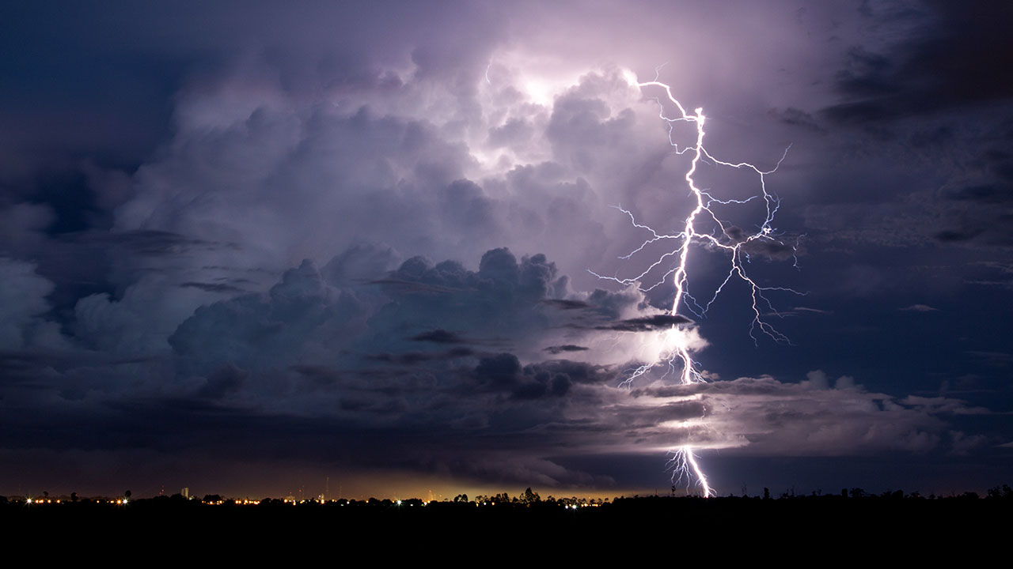
Heavens Shaken

Slide 38
Heavens Shaken
The voice of thy thunder was in the heaven. Psalm 77:18

Slide 39
Heavens Shaken
The voice of thy thunder was in the heaven. Psalm 77:18
And I heard a voice from heaven, as the voice of many waters,
and as the voice of a great thunder. Revelation 14:2

Slide 40
Heavens Shaken
The voice of thy thunder was in the heaven. Psalm 77:18
And I heard a voice from heaven, as the voice of many waters,
and as the voice of a great thunder Revelation 14:2
And he cried mightily with a strong voice, saying, Babylon the great is fallen, is fallen, and is become the habitation of devils, and the hold of every foul spirit, and a cage of every unclean and hateful bird.
For all nations have drunk of the wine of the wrath of her fornication, and the kings of the earth have committed fornication with her, and the merchants of the earth are waxed rich through the abundance of her delicacies.
Revelation 18:2,3

Slide 41
Heavens Shaken
1970’s: Vatican Bank Scandal
1970’s – 1990’s: Child Sexual Abuse
2002: Boston Globe “Spotlight” Exposé
Conclave

Slide 42
Heavens Shaken
1970’s: Vatican Bank Scandal
1970’s – 1990’s: Child Sexual Abuse
2002: Boston Globe “Spotlight” Exposé
Conclave
Judgment also will I lay to the line, and righteousness to the plummet: and the hail shall sweep away the refuge of lies, and the waters shall overflow the hiding place
Isaiah 28:17

Slide 43
Heavens Shaken
Televangelists

Slide 44
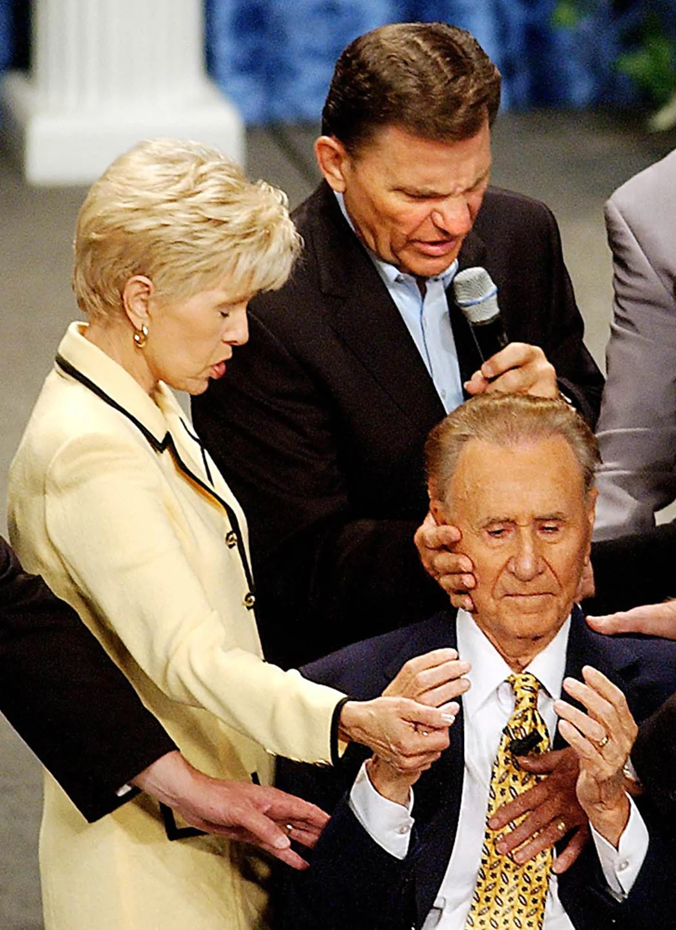
Heavens Shaken
Televangelists
Kenneth Copeland

Slide 45
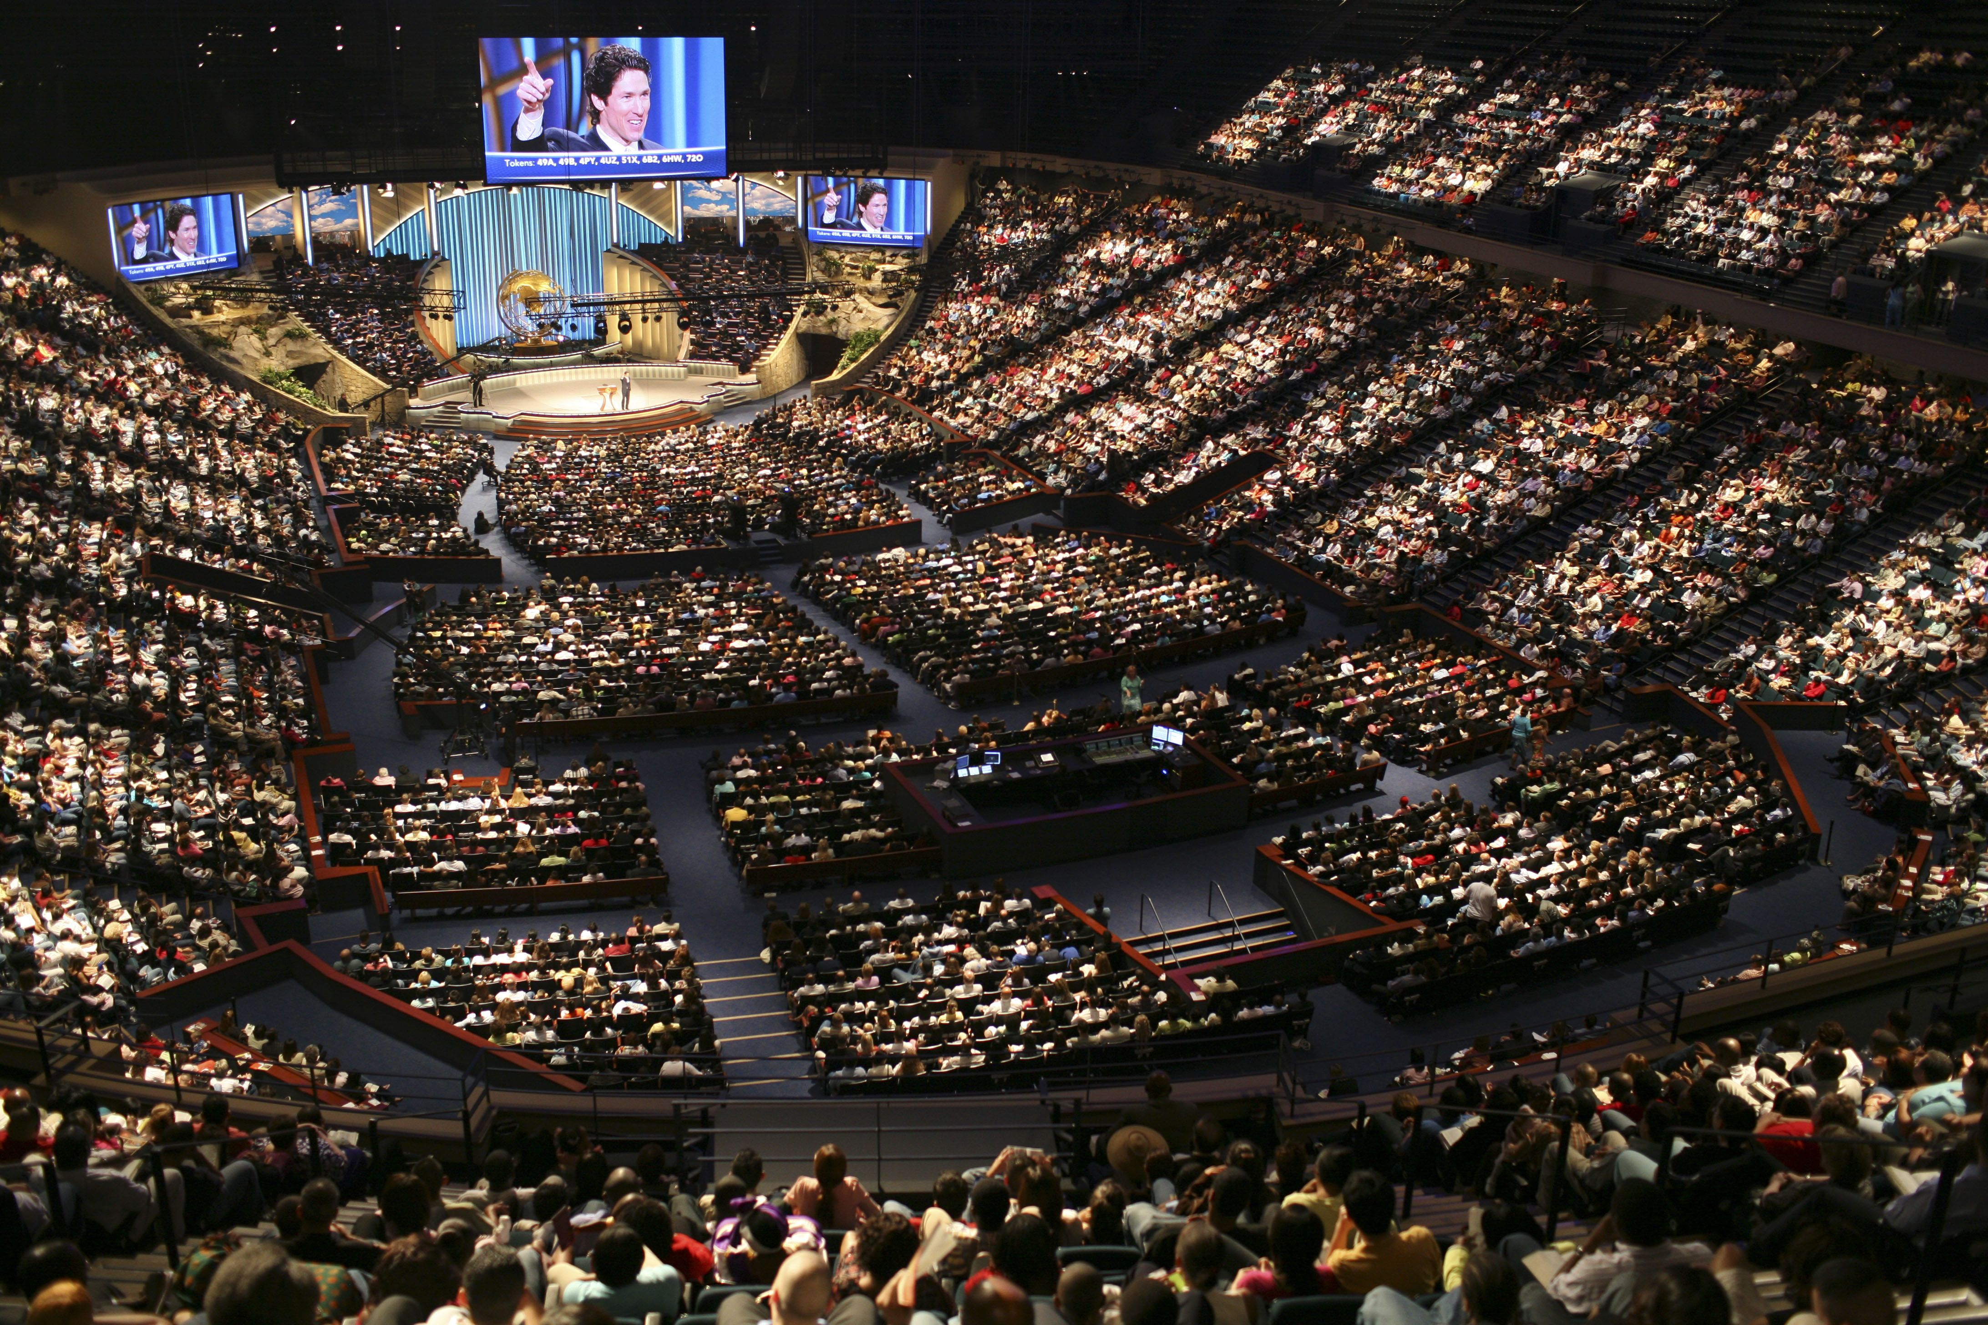
Heavens Shaken
Televangelists
Kenneth Copeland
Joel Osteen

Slide 46

Heavens Shaken
Televangelists
Kenneth Copeland
Joel Osteen
Paula White

Slide 47

Heavens Shaken
Televangelists
Kenneth Copeland
Joel Osteen
Paula White
L. Ron Hubbard: “You don't get rich writing science fiction.
If you want to get rich, you start a religion.”

Slide 48
Earth Shaken

Slide 49

Earth Shaken

Slide 50
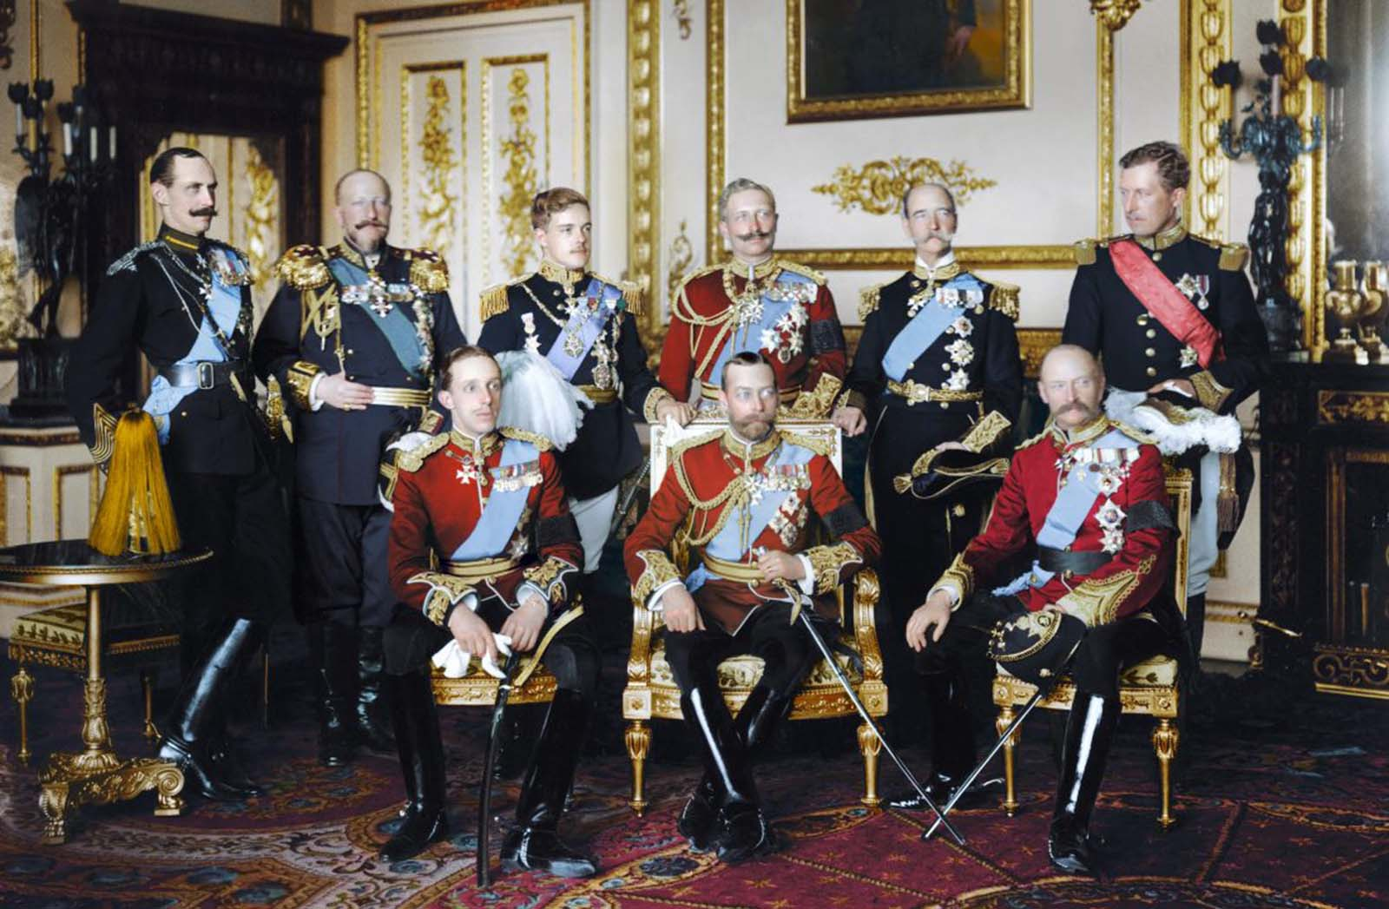
Earth Shaken

Slide 51
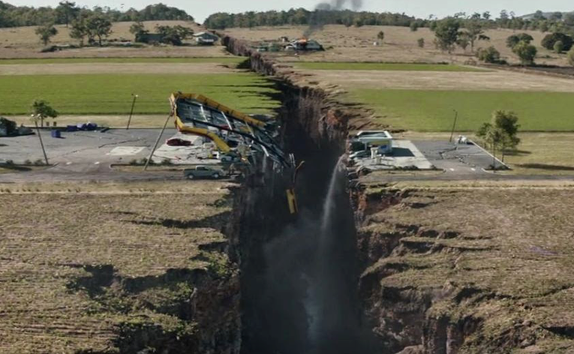
Earth Shaken

Slide 52
Earth Shaken

Slide 53
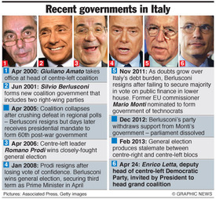
Earth Shaken

Slide 54
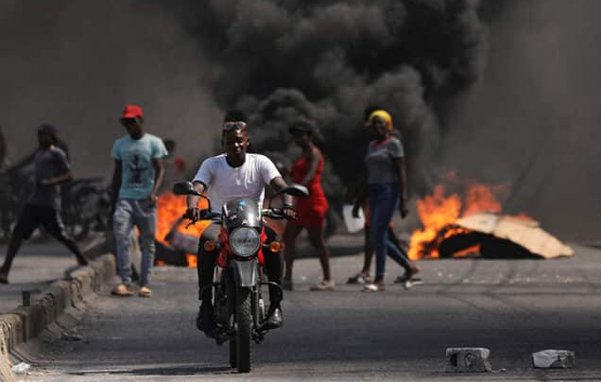
Earth Shaken

Slide 55

Earth Shaken

Slide 56
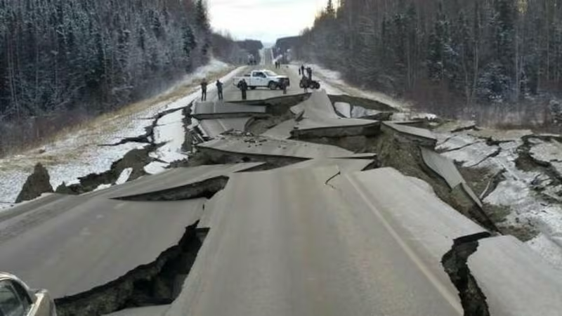
Earth Shaken

Slide 57
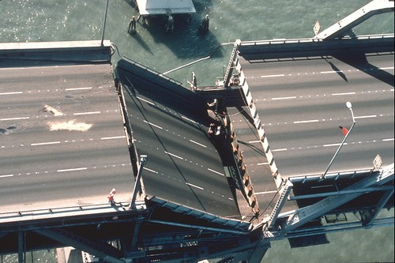
Earth Shaken

Slide 58
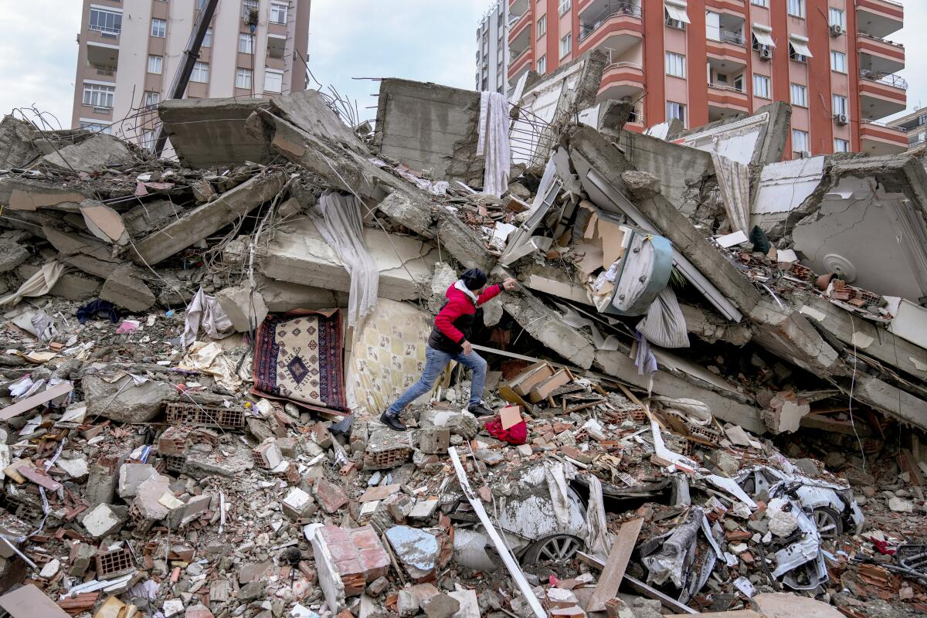
Earth Shaken

Slide 59

Earth Shaken

Slide 60

Earth Shaken

Slide 61

Earth Shaken

Slide 62
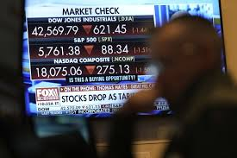
Earth Shaken

Slide 63

Seas Shaken

Slide 64
Seas Shaken
Causes: (1) Waves
(2) Earthquake - Tsunami

Slide 65
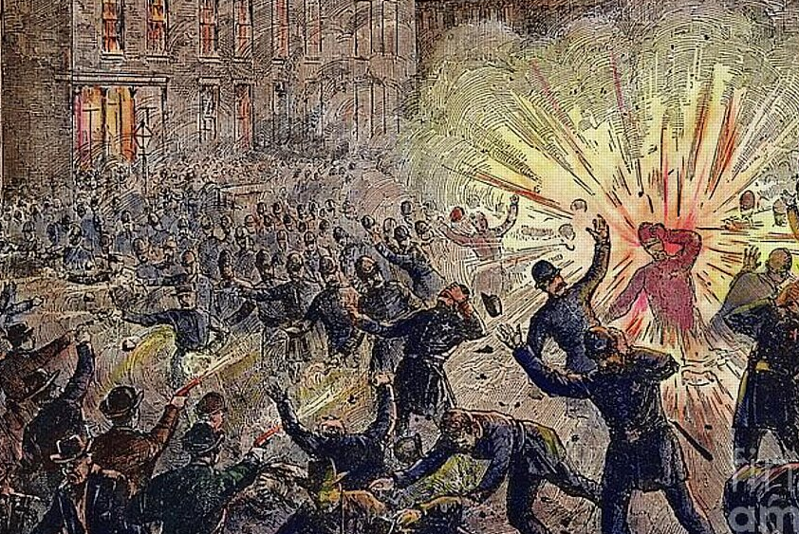
Seas Shaken

Slide 66
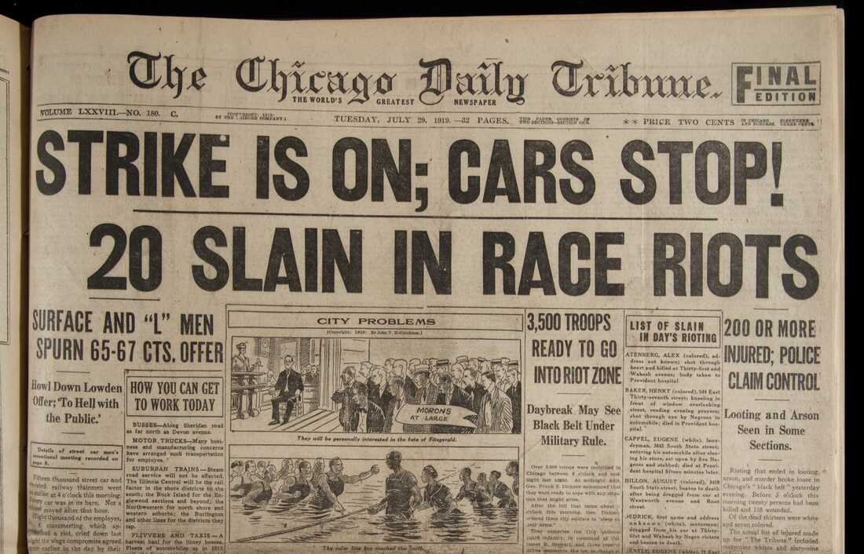
Seas Shaken

Slide 67

Seas Shaken

Slide 68

Seas Shaken

Slide 69

Seas Shaken

Slide 70

Seas Shaken

Slide 71
Seas Shaken
Causes: (1) Waves
(2) Earthquake - Tsunami

Slide 72
Dry Land Shaken

Slide 73

Dry Land Shaken

Slide 74

Dry Land Shaken

Slide 75
All Nations Shaken

Slide 76
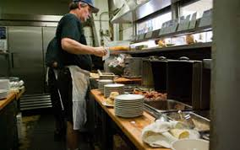
All Nations Shaken

Slide 77

All Nations Shaken

Slide 78

All Nations Shaken

Slide 79
All Nations Shaken
Men's hearts failing them for fear, and for looking after those things which are coming on the earth: for the powers of heaven shall be shaken.
Luke 21:26

Slide 80
All Nations Shaken
And I will shake all nations, and the desire of all nations shall come: and I will fill this house with glory, saith the LORD of hosts
Haggai 2:7

Slide 81
All Nations Shaken
And I will shake all goy, and the desire of all goy shall come: and I will fill this house with glory, saith the LORD of hosts
Haggai 2:7

Slide 82
The Good News
. . . and the desire of all nations shall come: and I
will fill this house with glory, saith the LORD of hosts
Haggai 2:7

Slide 83
The Good News
. . . and the desire of all nations shall come: and I will fill this house with glory, saith the LORD of hosts
Haggai 2:7

Slide 84
Close your eyes for a moment to the scenes of misery and woe, degradation and sorrow that yet prevail on account of sin, and picture before your mental vision the glory of the perfect earth. Not a stain of sin mars the harmony and peace of a perfect society; not a bitter thought, not an unkind look or word; love, welling up from every heart, meets a kindred response in every other heart, and benevolence marks every act. There sickness shall be no more; not an ache nor a pain, nor any evidence of decay--not even the fear of such things . . .

Slide 85
. . . Think of all the pictures of comparative health and beauty of human form and feature that you have ever seen, and know that perfect humanity will be of still surpassing loveliness. The inward purity and mental and moral perfection will stamp and glorify every radiant countenance. Such will earth's society be; and weeping bereaved ones will have their tears all wiped away, when thus they realize the resurrection work complete.
Volume 1 Page 192

Slide 86
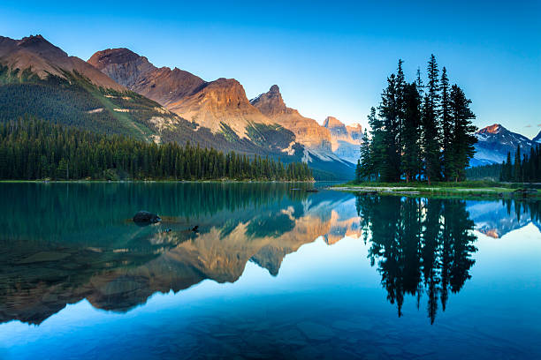

Slide 87
The Good News
. . . and the desire of all nations shall come: and
I will fill this house with glory, saith the LORD of hosts Haggai 2:7

Slide 88
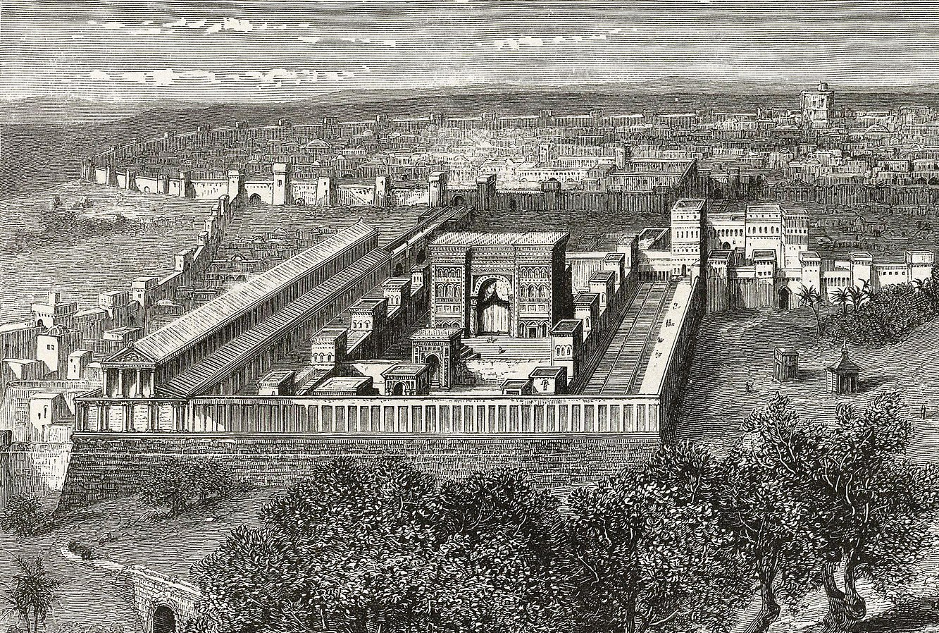
The Good News
. . . and the desire of all nations shall come: and
I will fill this house with glory, saith the LORD of hosts Haggai 2:7

Slide 89
The Good News
. . . and the desire of all nations shall come: and
I will fill this house with glory, saith the LORD of hosts Haggai 2:7
And what agreement hath the temple of God with idols? for ye are the temple of the living God; as God hath said, I will dwell in them, and walk in them; and I will be their God, and they shall be my people.
Wherefore come out from among them, and be ye separate, saith the Lord, and touch not the unclean thing; and I will receive you,
2Corinthians 6:16,17

Slide 90
The Good News
. . . and the desire of all nations shall come: and
I will fill this house with glory, saith the LORD of hosts Haggai 2:7
Ye also, as lively (or living) stones, are built up a spiritual house, an holy priesthood, to offer up spiritual sacrifices, acceptable to God by Jesus Christ.
1Peter 2:5

Slide 91
Character Lessons

Slide 92
Character Lessons
1. Stay Above the Fray

Slide 93
. . . some, we believe, have gone to an extreme in denouncing present institutions in a manner that the Lord and the apostles neither commanded nor sanctioned, nor illustrated in their words and conduct. Simply making people discontented with their present conditions and surroundings is most unwise. On the contrary, the influence, the spirit, the disposition, of the New Creation should always be toward peace; and if we cannot commend present institutions highly, neither need we specially condemn them.

Slide 94
The agitation of these matters in advance will be not only unavailing, but worse-- disadvantageous, injurious--both to the agitator and the agitated, breeding discontent. Amongst the children of this world there will be found plenty of agitators when the Lord's time shall come for these questions to be agitated. Meantime all the members of the New Creation will display wisdom in avoiding such questions as tend to strife and discontent . . .
Volume Six Page 607

Slide 95
Character Lessons
1. Stay Above the Fray
2. Consider Your Ways

Slide 96
Character Lessons
1. Stay Above the Fray
2. Consider Your Ways
- Self-examination

Slide 97
Character Lessons
1. Stay Above the Fray
2. Consider Your Ways
- Self-examination
- Touch lightly the things of earth

Slide 98
Character Lessons
1. Stay Above the Fray
2. Consider Your Ways
- Self-examination
- Touch lightly the things of earth
- Accept chastenings

Slide 99
Character Lessons
1. Stay Above the Fray
2. Consider Your Ways
- Self-examination
- Touch lightly the things of earth
- Accept chastenings
- Be clean, pure, undefiled

